Slide 1
MARKETING EXECUTIVE PROGRESS ANALYZER
TEAM MEMBERS
R.Anish
M.Arshath
R.Nagaimugan
A.Aravind
FACULTY GUIDE
B.Lanitha
Department of CSE, KGiSL Institute of Technology, Coimbatore

Slide 2
Abstract
The functionalities includes target allocations, performance measurement, lead management handled in the hierarchy of Territory Manager, Zonal Manager, Branch Manager ,Team Leader, and Member.
Target allocations, changes in existing targets and target completions is captured as notifications and informed to the employees.
It includes To-do list that helps to create and prioritize the reminders related to target allocations and other events.
Messaging option helps for inter departmental communications between the employees to share various informations.

Slide 3
Existing system and its disadvantage
Draw Backs:
It only focuses on customer relationship management. It does not provide the additional modules that manages the marketing process of a company.
That is not device compatibility.
The analysis towards employee performance and tracing the performance of the team, branch, zonal, territory is not available.

Slide 4
PROPOSED SYSTEM
Easy way of measuring the performance of marketing strategies.
It helps to increase the overall performance of overall sales team and workforce.
It helps to allocate the right product for the right employee to enhance the sales level.
Device compatibility Application.

Slide 5
Module split-up
Dash Board
Masters
Products Management
Marketing Targets
Leads and Feedback
Department of CSE, KGiSL Institute of Technology, Coimbatore

Slide 6
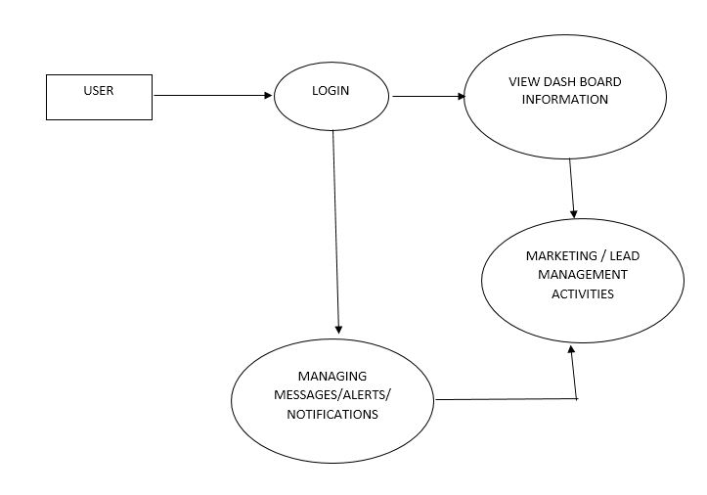
Architectural Design

Slide 7
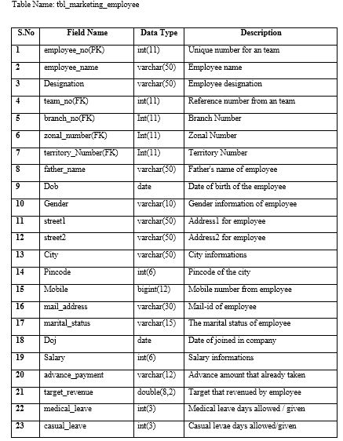

Slide 8
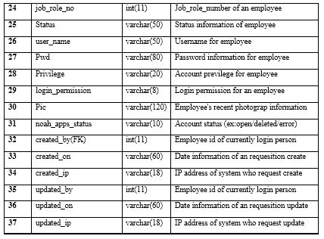

Slide 9
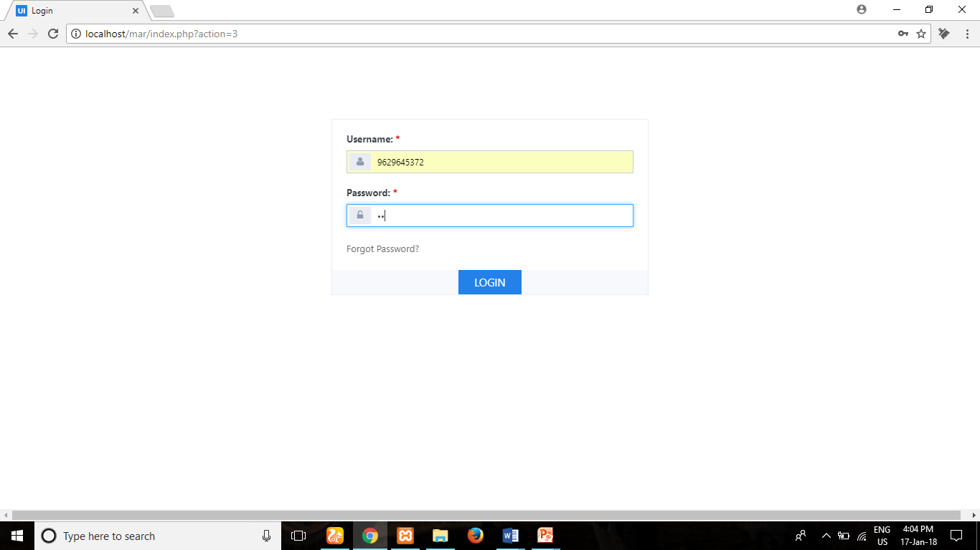
Screen Shot
Department of CSE, KGiSL Institute of Technology, Coimbatore

Slide 10
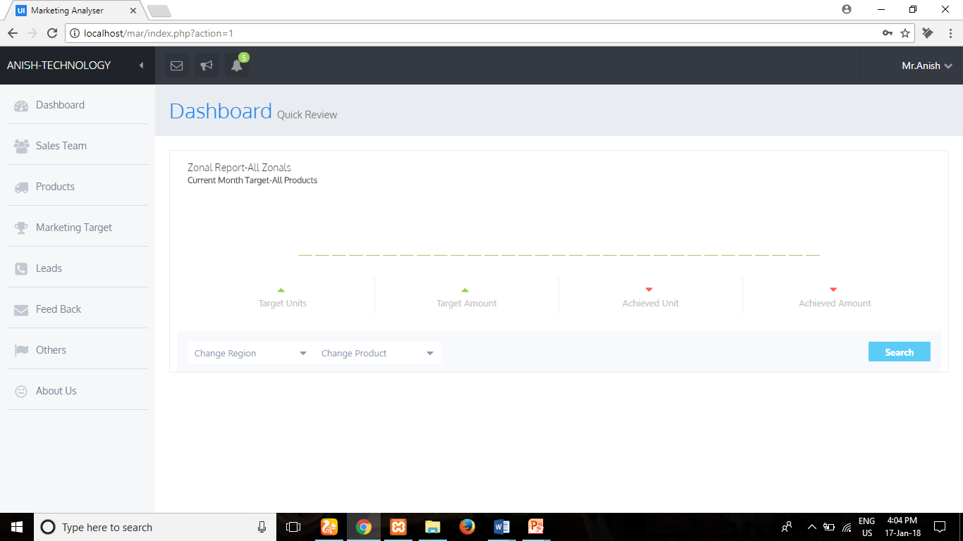

Slide 11
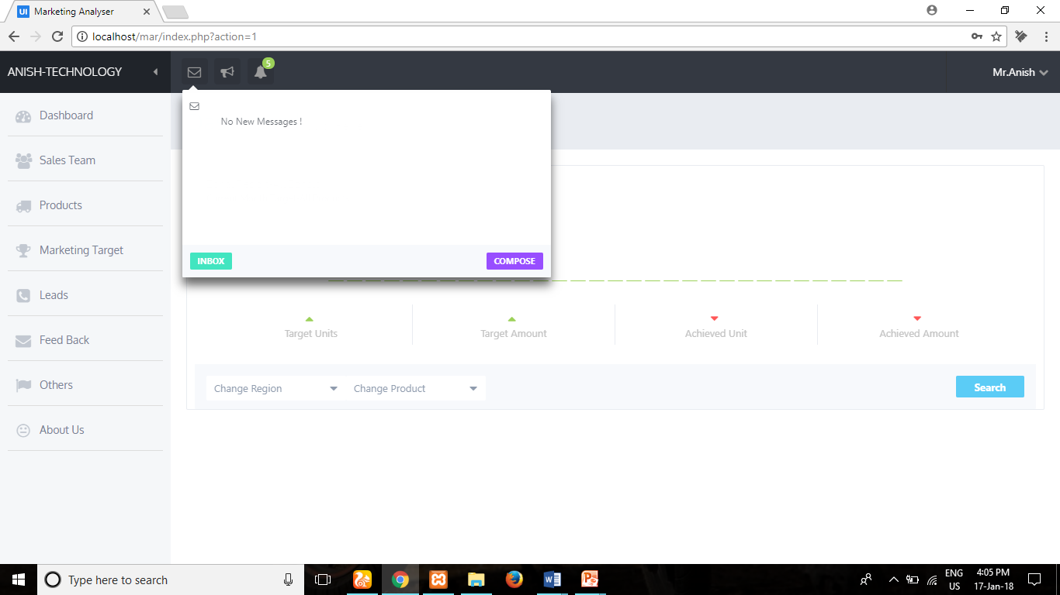

Slide 12
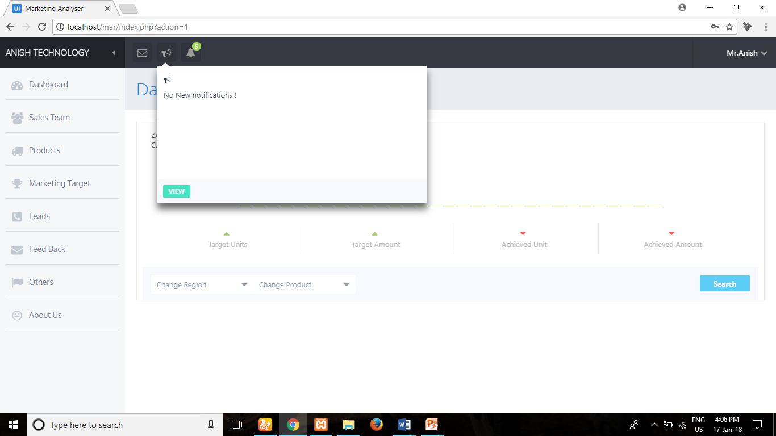

Slide 13
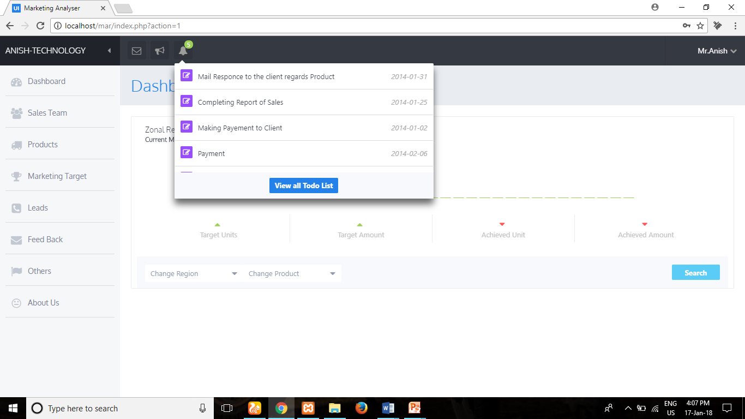

Slide 14
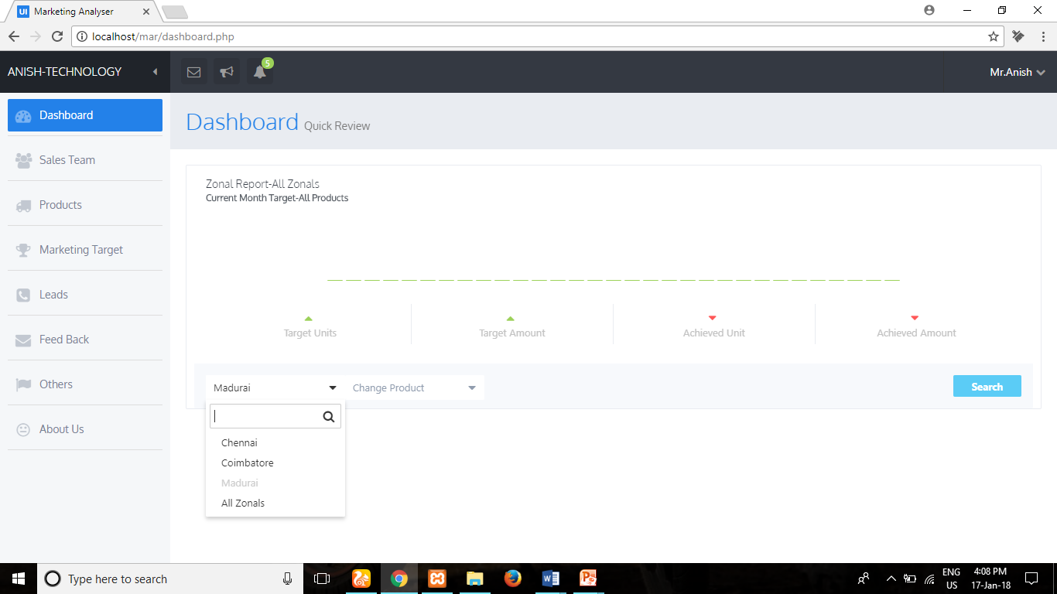

Slide 15
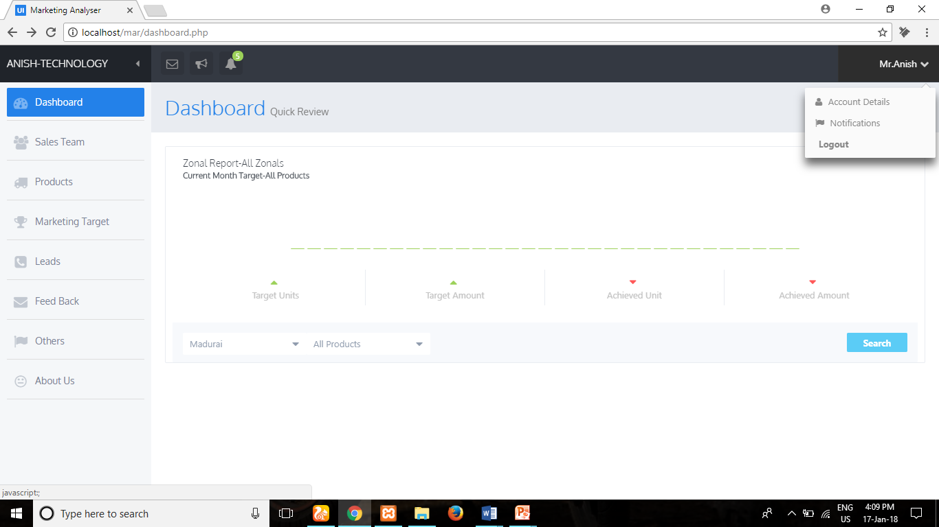

Slide 16
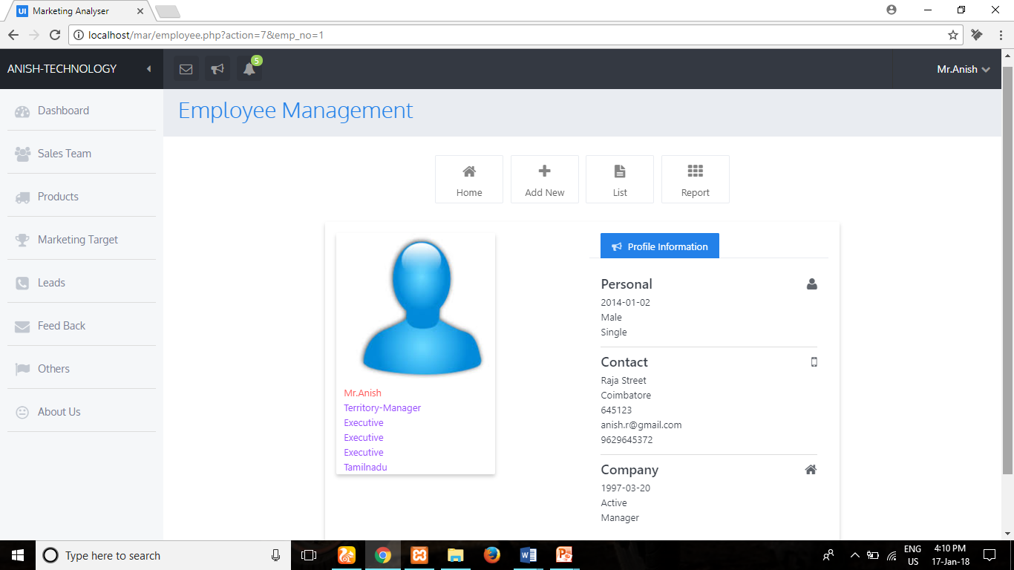

Slide 17
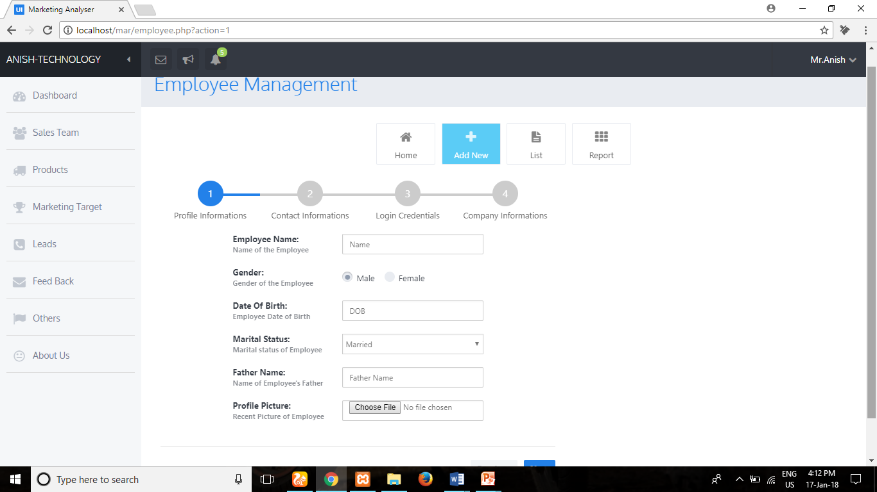

Slide 18
Reference
WWW.Phpinfo.com
www.stackoverflow.com
www.w3schools.com
Department of CSE, KGiSL Institute of Technology, Coimbatore

Slide 19
THANK YOU

